Slide 1
The Process of Usability Engineering
Usability Engineering: Process, Products, and Examples
Chapter 4

Slide 2
Building a User Interface
Building a User Interface is part of the larger problem of building a software system.
Software development is hard.
  Software development is an example of a wicked problem.

Slide 3
User Interface Development Changes Software Development
Adding a significant user interface to a software development project adds challenges.
  Support for connectivity.
  Support for media.
  Support for user-tailoring.
Notes:
Cf. Myers, 1994

Slide 4
Activities in Software Engineering
Understanding and documenting the context of the project.
Understanding and documenting the problem to be solved
Designing and documenting a solution in the context.
Implementing the solution.
Testing and evaluating the solution.

Slide 5
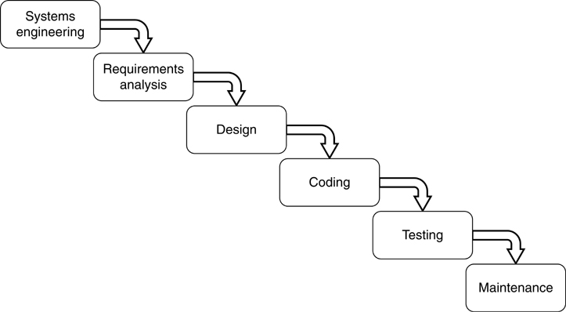
The Waterfall Model of Software Development

Slide 6
Phases of the Waterfall Model
Systems engineering and analysis
Software requirements analysis
Software design
Code
Testing
Maintenance

Slide 7
Benefits of Exactly Following the Waterfall Model
Following any methodology imposes discipline on the software development process.
Following a phased model improves cost and resource forecasting.

Slide 8
Problems of Following the Waterfall Model
Does not inherently support iteration.
Requires customer to completely elaborate requirements at the beginning of the project.
Customer will not see an artifact until late in the development cycle.

Slide 9
Activities of Usability Engineering
Understanding and documenting the context of the project.
Understanding and documenting the problem to be solved.
Designing and documenting a solution in the context.
Implementing the solution.
Testing and evaluating the solution.
Notes:
Note that in the abstract, the activities are the same as for software engineering.

Slide 10
Usability and Software Engineering
In the abstract, the steps for both tasks are the same.
We can set up parallel flows of activities for both usability and software engineering.
The model supports iteration.

Slide 11
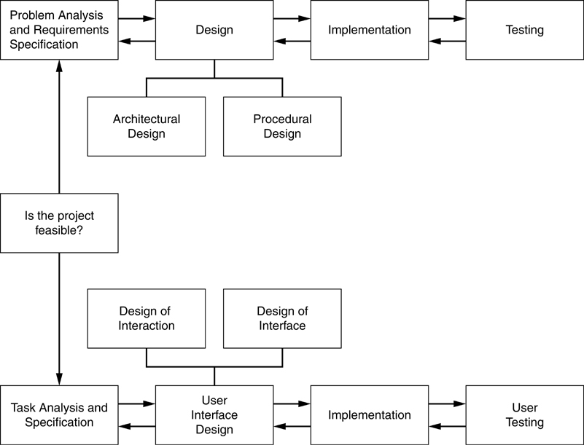
Usability and Software Engineering Activities

Slide 12
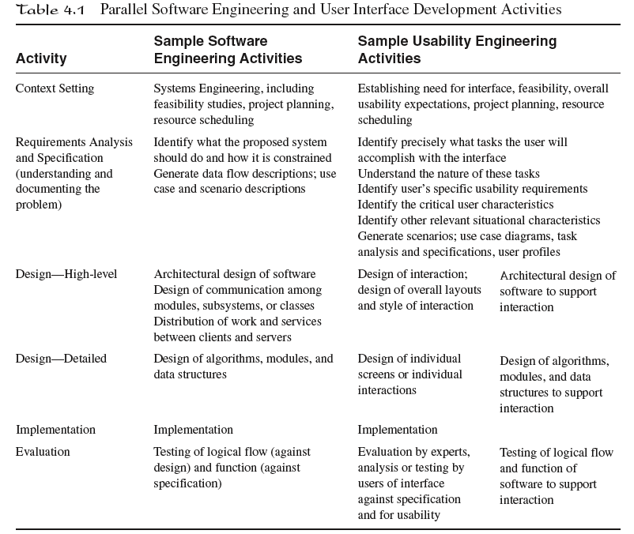
Usability and Software Engineering Activities

Slide 13
The Development Team
Building a good interface is often the result of the efforts of a team.

Slide 14
Development Team Structure
Distribution of activities and communications
    Chief programmer team
    Egoless programming
Choice depends on group dynamic and type of problem
    Exploratory problems may work better with egoless programming where familiar well-structured problems may be better with a chief programmer structure.

Slide 15
Participatory Design
Users are members of the development team and work closely with the designers.
Advocates of participatory design stress that the participatory aspect leads to greater buy-in from users and hence higher user satisfaction.

Slide 16
Conclusions
Usability and software engineering always follow a process.
Usability engineering often takes place in the larger context of software engineering.

